Slide 1
Chapter 16 – Files and Streams

Slide 2
Goals
To be able to read and write text files
To become familiar with the concepts of text and binary formats
To learn about encryption
To understand when to use sequential and random file access
To be able to read and write objects using serialization

Slide 3
keyboard
standard input stream
CPU
standardoutput stream
MEM
monitor
terminal
console
HDD
What does information travel across?
Streams
Notes:
Used tootsie roll pieces as data bytes and a large tootsie roll as a line of data on a cardboard card and drawing on the chalkboard.

Slide 4
keyboard
standard input stream
CPU
standardoutput stream
MEM
monitor
terminal
console
file
input stream
LOAD
READ
HDD
What does information travel across?
file output stream
SAVE
WRITE
Streams
files
Notes:
Used tootsie roll pieces as data bytes and a large tootsie roll as a line of data on a cardboard card and drawing on the chalkboard.

Slide 5
Reading and Writing Text Files
Text files – files containing simple text
  Created with editors such as notepad, html, etc.
Simplest way to learn it so extend our use of Scanner
  Associate with files instead of System.in
All input classes, except Scanner, are in java.io
  import java.io.*;

Slide 6
Review: Scanner
We've seen Scanner before
The constructor takes an object of type java.io.InputStream – stores information about the connection between an input device and the computer or program
  Example: System.in
Recall – only associate one instance of Scanner with System.in in your program
  Otherwise, get bugs

Slide 7
Numerical Input
2 ways (we’ve learned one, seen the other)
  Use int as example, similar for double
First way:
  Use nextInt()
  int number = scanner.nextInt();
Second way:
  Use nextLine(), Integer.parseInt()
  String input = scanner.nextLine();
  int number = Integer.parseInt(input);

Slide 8
Numerical Input
Exceptions
  nextInt() throws InputMismatchException
  parseInt() throws NumberFormatException
Optimal use
  nextInt() when there is multiple information on one line
  nextLine() + parseInt() when one number per line

Slide 9
Reading Files
The same applies for both console input and file input
We can use a different version of a Scanner that takes a File instead of System.in
Everything works the same!

Slide 10
Reading Files
To read from a disk file, construct a FileReader
Then, use the FileReader to construct a Scanner object
FileReader rdr = newFileReader("input.txt");
Scanner fin = new Scanner(rdr);

Slide 11
Reading Files
You can use File instead of FileReader
  Has an exists() method we can call to avoid FileNotFoundException
File file = new File ("input.txt");
Scanner fin;
if(file.exists()){
fin = new Scanner(file);
} else {
//ask for another file
}

Slide 12
Reading Files
Once we have a Scanner, we can use methods we already know:
  next, nextLine, nextInt, etc.
Reads the information from the file instead of console

Slide 13
File Class
java.io.File
  associated with an actual file on hard drive
  used to check file's status
Constructors
  File(<full path>)
  File(<path>, <filename>)
Methods
  exists()
  canRead(), canWrite()
  isFile(), isDirectory()

Slide 14
File Class
java.io.FileReader
  Associated with File object
  Translates data bytes from File object into a stream of characters (much like InputStream vs. InputStreamReader)
Constructors
  FileReader( <File object> );
Methods
  read(), readLine()
  close()

Slide 15
Writing to a File
We will use a PrintWriter object to write to a file
  What if file already exists? → Empty file
  Doesn’t exist? → Create empty file with that name
How do we use a PrintWriter object?
  Have we already seen one?

Slide 16
Writing to a File
The out field of the System class is a PrintWriter object associated with the console
  We will associate our PrintWriter with a file now
PrintWriter fout = new PrintWriter("output.txt");
fout.println(29.95);
fout.println(new Rectangle(5, 10, 15, 25));
fout.println("Hello, World!");
This will print the exact same information as with System.out (except to a file “output.txt”)!

Slide 17
Closing a File
Only main difference is that we have to close the file stream when we are done writing
If we do not, not all output will written
At the end of output, call close()
fout.close();

Slide 18
Closing a File
Why?
  When you call print() and/or println(), the output is actually written to a buffer. When you close or flush the output, the buffer is written to the file
  The slowest part of the computer is hard drive operations – much more efficient to write once instead of writing repeated times

Slide 19
File Locations
When determining a file name, the default is to place in the same directory as your .class files
If we want to define other place, use an absolute path (e.g. c:\My Documents)
in = new FileReader(“c:\\homework\\input.dat”);
Why \\ ?

Slide 20
Sample Program
Two things to notice:
  Have to import from java.io
  I/O requires us to catch checked exceptions
    java.io.IOException

Slide 21
Java Input Review
CONSOLE:
Scanner stdin = new Scanner( System.in );
FILE:
Scanner inFile = new Scanner( new FileReader(srcFileName ));

Slide 22
Java Output Review
CONSOLE:
  System.out.print("To the screen");
FILE:
  PrintWriter fout =
  new PrintWriter(new File("output.txt");
  fout.print("To a file");

Slide 23
import java.io.FileReader;
import java.io.IOException;
import java.io.PrintWriter;
import java.util.Scanner;
public class LineNumberer{
public static void main(String[] args){
Scanner console = new Scanner(System.in);
System.out.print("Input file: ");
String inFile = console.next();
System.out.print("Output file: ");
String outFile = console.next();
try{
FileReader reader = new FileReader(inFile);
Scanner in = new Scanner(reader);

Slide 24
      PrintWriter out = new PrintWriter(outputFileName);
      int lineNumber = 1;
      while (in.hasNextLine()){
      String line = in.nextLine();
      out.println("/* " + lineNumber + " */ " + line);
      lineNumber++;
      }
      out.close();
    } catch (IOException exception){
    System.out.println("Error processing file: " + exception);
    }
  }
}

Slide 25
An Encryption Program
Demonstration: Use encryption to show file techniques
File encryption
  To scramble a file so that it is readable only to those who know the encryption method and secret keyword
  (Big area of CS in terms of commercial applications – biometrics, 128-bit encryption breaking, etc.)

Slide 26
Modifications of Output
Two constraints so far:
  Files are overwritten
  Output is buffered and not written immediately
We have options to get around this

Slide 27
File Class
java.io.FileWriter
  Associated with File object
  Connects an output stream to write bytes of info
Constructors
  FileWriter( <filename>, <boolean> );
    true to append data, false to overwrite all of file
This will overwrite an existing file
  To avoid, create File object and see if exists() is true

Slide 28
Java File Output
PrintWriter
  composed from several objects
    PrintWriter out =
    new PrintWriter(
    new FileWriter( dstFileName, false ), true );
  requires throws FileNotFoundException,
  which is a sub class of IOException
Methods
  print(), println(): buffers data to write
  flush(): sends buffered output to destination
  close(): flushes and closes stream
Notes:
FileWriter with second argument of false will overwrite.
The second arg is true if you want to append.
The default is false and will overwrite the file.
PrintWriter with second argument of true will autoflush on println calls.

Slide 29
Java File Output
// With append to an existing file
PrintWriter outFile1 =
new PrintWriter(
new FileWriter(dstFileName,true),false);
// With autoflush on println
PrintWriter outFile2 =
new PrintWriter(
new FileWriter(dstFileName,false),true);
outFile1.println( “appended w/out flush” );
outFile2.println( “overwrite with flush” );

Slide 30
To flush or not to flush
Advantage to flush:
  Safer – guaranteed that all of our data will write to the file
Disadvantage
  Less efficient – writing to file takes up time, more efficient to flush once (on close)

Slide 31
Caeser Cipher
Encryption key – the function to change the value
Simple key – shift each letter over by 1 to 25 characters
  If key = 3, A → D B → E etc.
Decryption = reversing the encryption
  Here we just subtract the key value

Slide 32
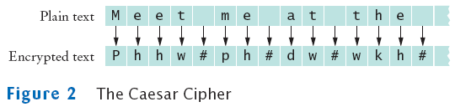

Slide 33
Binary File Encryption
int next = in.read();
if (next == -1)
done = true;
else {
byte b = (byte) next;
//call the method to encrypt the byte
byte c = encrypt(b);
out.write(c);
}

Slide 34
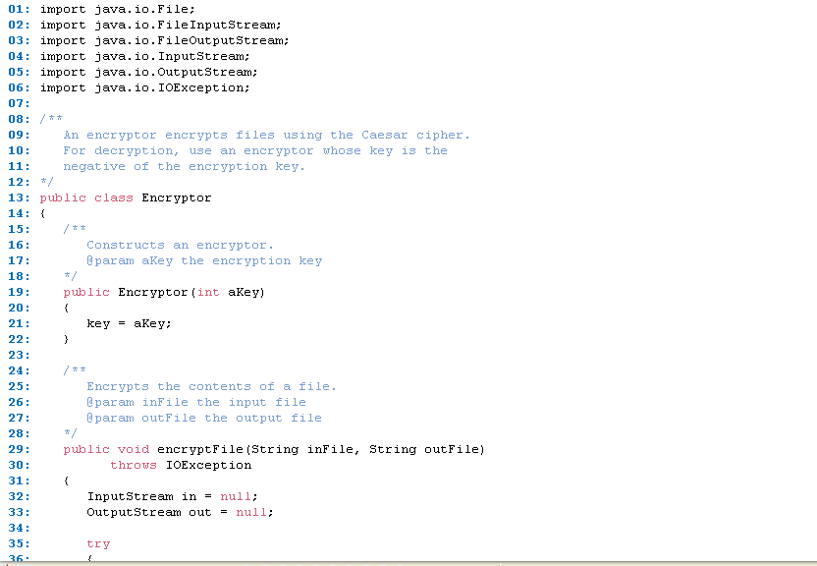

Slide 35
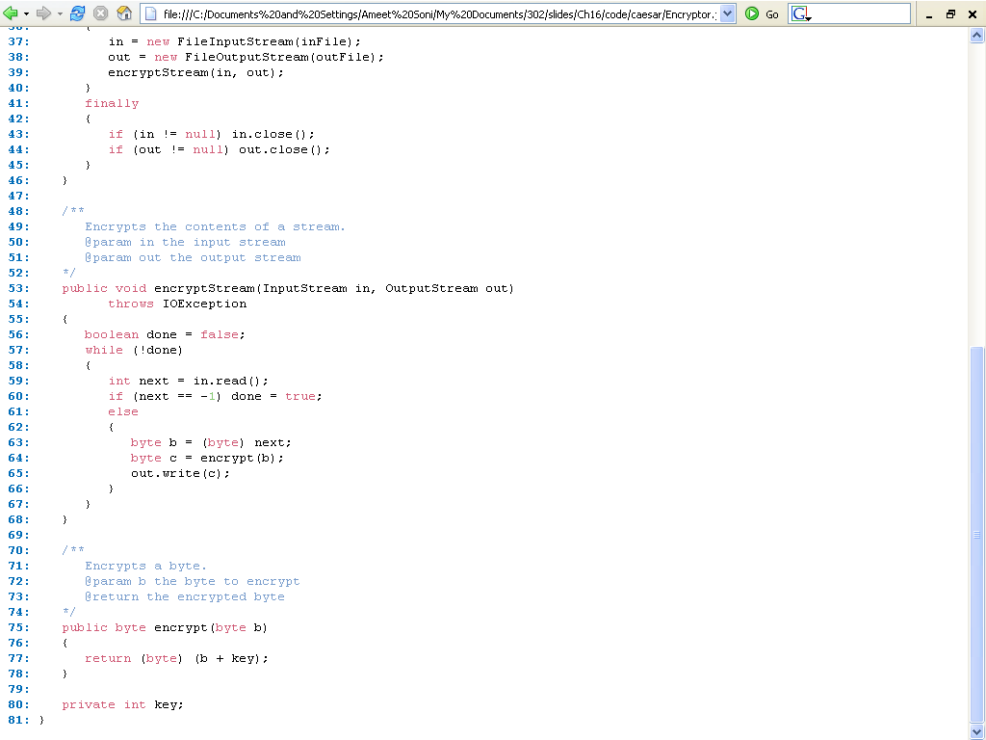

Slide 36
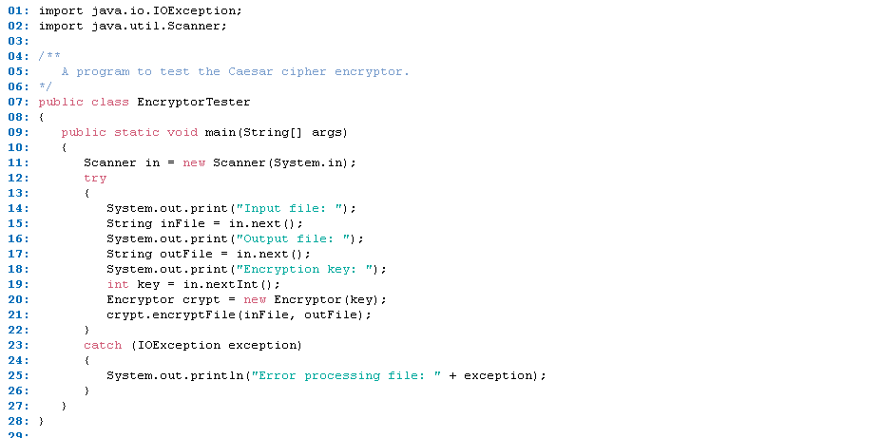

Slide 37
Object Streams
Last example read BankAccount field individually
  Easier way to deal with whole object
ObjectOutputStream class can save a entire objects to disk
ObjectOutputStream class can read objects back in from disk
Objects are saved in binary format; hence, you use streams and not writers

Slide 38
Write out an object
The object output stream saves all instance variables
BankAccount b = . . .;
ObjectOutputStream out = new ObjectOutputStream( new FileOutputStream("bank.dat"));
out.writeObject(b);

Slide 39
Read in an object
readObject returns an Object reference
Need to remember the types of the objects that you saved and use a cast
ObjectInputStream in = new ObjectInputStream( new FileInputStream("bank.dat"));
BankAccount b = (BankAccount) in.readObject();

Slide 40
Exceptions
readObject method can throw a ClassNotFoundException
It is a checked exception
You must catch or declare it

Slide 41
Writing an Array
Usually want to write out a collection of objects:
BankAccount[] arr = new BankAccount[size];
// Now add size BankAccount objects into arr
out.writeObject(arr);

Slide 42
Reading an Array
To read a set of objects into an array
BankAccount[] ary = (BankAccount[]) in.readObject();

Slide 43
Object Streams
Very powerful features
  Especially considering how little we have to do
The BankAccount class as is actually will not work with the stream
  Must implement Serializable interface in order for the formatting to work

Slide 44
Object Streams
class BankAccount implements Serializable
{
. . .
}
IMPORTANT: Serializable interface has no methods.
No effort required

Slide 45
Serialization
Serialization: process of saving objects to a stream
  Each object is assigned a serial number on the stream
  If the same object is saved twice, only serial number is written out the second time
  When reading, duplicate serial numbers are restored as references to the same object

Slide 46
Serialization
Why isn’t everything serializable?
  Security reasons – may not want contents of objects printed out to disk, then anyone can print out internal structure and analyze it
  Example: Don’t want SSN ever being accessed
  Could also have temporary variables that are useless once the program is done running

Slide 47
Tokenizing
Often several text values are in a single line in a file to be compact
    “25 38 36 34 29 60 59”
The line must be broken into parts (i.e. tokens)
    “25”
    “38”
    “36”
tokens then can be parsed as needed
    “25” can be turned into the integer 25

Slide 48
Tokenizing
Inputting each value on a new line makes the file very long
May want a file of customer info – name, age, phone number all on one line
File usually separate each piece of info with a delimiter – any special character designating a new piece of data (space in previous example)

Slide 49
Tokenizing in Java
use a StringTokenizer object
  default delimiters are: space, tab, newline, return
  requires: import java.util.*
Constructors
  StringTokenizer(String line)//default dlms
  StringTokenizer(String ln, String dlms)
Methods
  hasMoreTokens()
  nextToken()
  countTokens()

Slide 50
StringTokenizing in Java
Scanner stdin = new…
System.out.print( "Enter a line with comma seperated integers(no space): " );
String input = stdin.nextLine();
StringTokenizer st;
String delims = ",";
st = new StringTokenizer( input, delims );
while ( st.hasMoreTokens() )
{
int n = Integer.parseInt(st.nextToken());
System.out.println(n);
}

Slide 51
File gradeFile = new File(“scores.txt”);
if(gradeFile.exists()){
Scanner inFile = new Scanner(gradeFile);
String line = inFile.nextLine();
while(line != null){
StringTokenizer st = new StringTokenizer(line, ":");
System.out.print(" Name: " + st.nextToken());
int num = 0;
double sum = 0;
while ( st.hasMoreTokens() )
{
num++;
sum += Integer.parseInt(st.nextToken());
}
System.our.println(" average = "+ sum/num);
line = inFile.nextLine();

Slide 52
}
inFile.close();
}
If you call nextToken() and there are no more tokens, NoSuchElementException is thrown

Slide 53
Tokenizing
Scanner tokenizes already…
Scanner in = new Scanner(…);
while(in.hasNext()) {
String str = in.next();
…
}

